Slide 1
Group 2 – futuro-house.net
Benjamin Acuff, Quay Robinson, Arnav Shah, Yoseph Shibiru

Slide 2
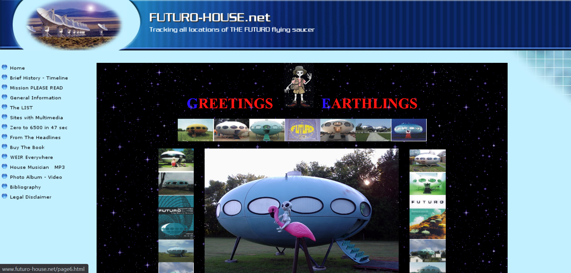
Futuro House Old Website – Index / Home Page

Slide 3
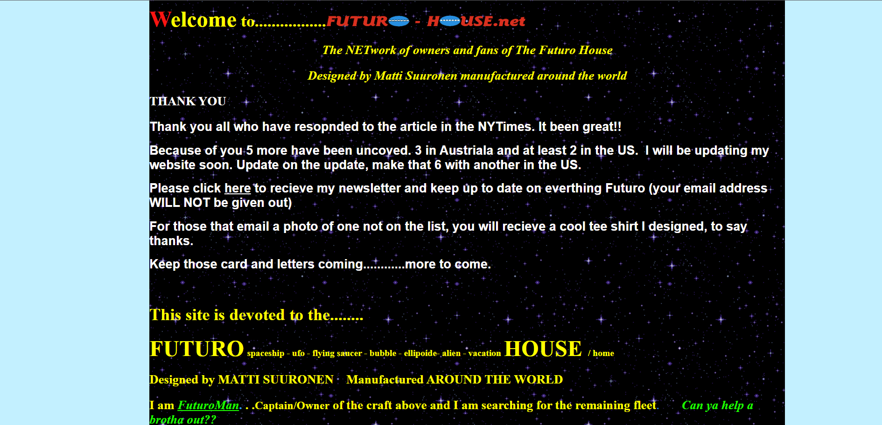
Middle of index / home page

Slide 4
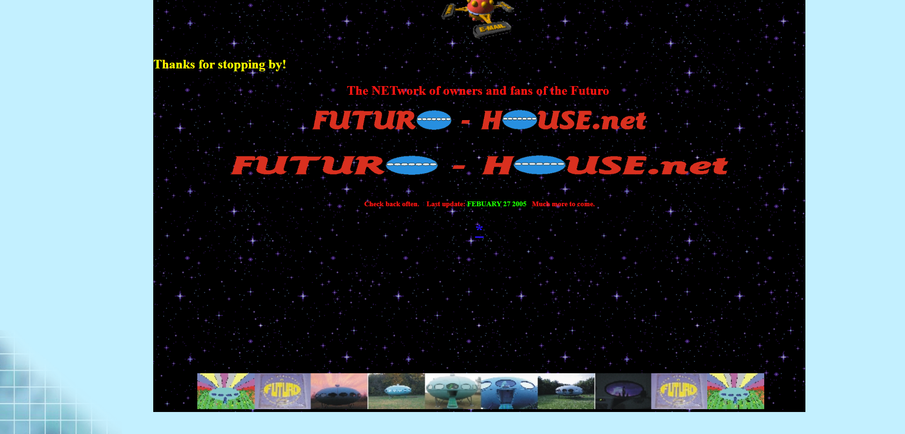
Bottom of index / home page

Slide 5
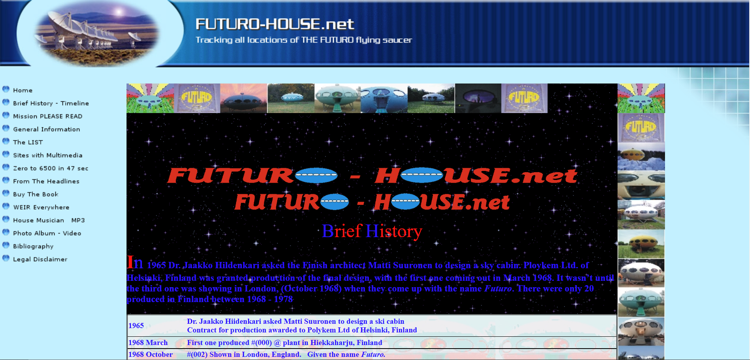
Brief History Page

Slide 6
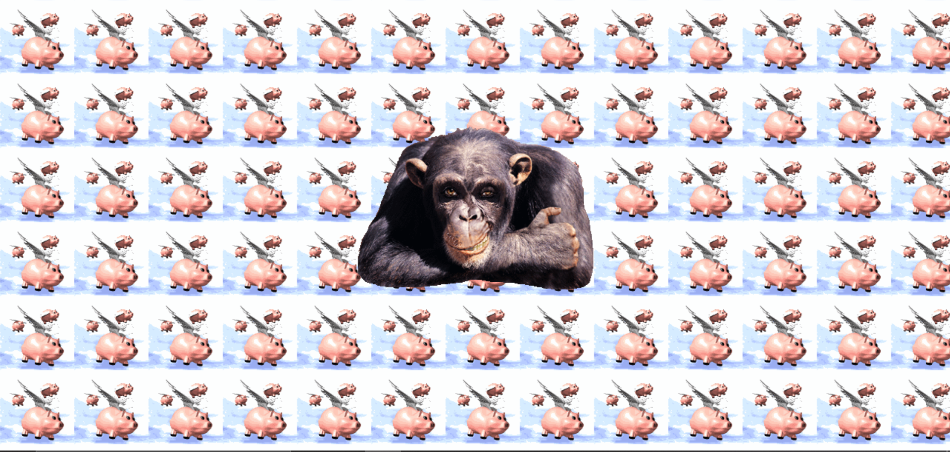
If you click on an image… this happens

Slide 7
Future House Original Website Pros and Cons
Cons
Bad Contrast
Bad Navigation
Bad Alignment
No consistency
Difficult to read
One page might contain too much information opposed to spreading the information out throughout the entire website
No footer
No contents in the aside section
Some of the links do not work
Images are spread inconsistently throughout
Pros
Images are cool
Header looks good on home page

Slide 8
Team Roles
Benjamin Acuff – Project Manager / Team Leader
Organized group and kept group on track to meet deadlines
Scheduled meeting times through email and teams
Helped design HTML files and CSS design ideas
Quay Robinson – Analyst / Designer
Collaborated ideas and planned out design project
Helped design HTML files and CSS design ideas
Looks at design in real time to make sure the file follows CSS and HTML guidelines
Yoseph Shibiru – Lead Designer / Organizer
Designed the CSS file we used for all the website’s HTML files
Helped design HTML files and coordinate image files
Responsible for putting all files together for final design
Arnav Shah – Tester / Designer
Tested and cleaned up any mistakes on a previously uploaded file
Helped design HTML files and CSS design ideas
Responsible for final testing and minimizing any mistakes

Slide 9
We will now present the new redesigned website, do a live demo, and take questions at the end. Thank you!

